Slide 1
Lecture 3
Introduction to agent
How agents should act
Structure of intelligent agents

Slide 2
Introduction to agent
An agent is anything that can be viewed as perceiving its environment through sensors and acting upon that environment through effectors.
A human agent has eyes, ears, and other organs for sensors, and hands, legs, mouth, and other body parts for effectors.
A robotic agent substitutes cameras and infrared range finders for the sensors and various motors for the effectors.
A software agent has encoded bit strings as its percepts and actions.

Slide 3
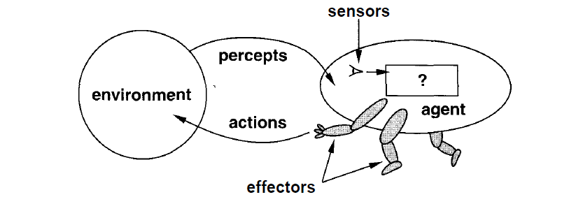
Agent interacting with environment through sensors and effectors

Slide 4
How agents should act
A rational agent is one that does the right thing.
Right action is the one that will cause the agent to be most successful.
That leaves us with the problem of deciding how and when to evaluate the agent's success.
We use the term performance measure for the how—the criteria that determine how successful an agent is.
There is not one fixed measure suitable for all agents.
We as outside observers establish a standard of what it means to be successful in an environment and use it to measure the performance of agents.
Example of vacuum a dirty floor by agent

Slide 5
The when of evaluating performance is also important.
If we measured how much dirt the agent had cleaned up in the first hour of the day, we would be rewarding those agents that start fast and punishing those that work consistently.
Thus, we want to measure performance over the long run, be it an eight-hour shift or a lifetime.
We need to be careful to distinguish between rationality and omniscience.
An omniscient agent knows the actual outcome of its actions, and can act accordingly; but omniscience is impossible in reality.
Example of crossing road and a door of plane falls down from sky

Slide 6
What is rational at any given time depends on four things:
The performance measure that defines degree of success.
Everything that the agent has perceived so far. We will call this complete perceptual history - the percept sequence.
What the agent knows about the environment.
The actions that the agent can perform.
Def : Ideal rational agent:
For each possible percept sequence, an ideal rational agent should do whatever action is expected to maximize its performance measure, on the basis of the evidence provided by the percept sequence and whatever built-in knowledge the agent has.

Slide 7
The ideal mapping from percept sequences to actions
Once we realize that an agent's behavior depends only on its percept sequence to date, then we can describe any particular agent by making a table of the action it takes in response to each possible percept sequence.
Such a list is called a mapping from percept sequences to actions.
We can, in principle, find out which mapping correctly describes an agent by trying out all possible percept sequences and recording which actions the agent does in response.
And if mappings describe agents, then ideal mappings describe ideal agents.
Specifying which action an agent should take in response to any given percept sequence provides a design for an ideal agent.

Slide 8
Autonomy
One more thing to deal with in the definition of an ideal rational agent: the "built-in knowledge" part.
If the agent's actions are based completely on built-in knowledge, such that it need pay no attention to its percepts, then we say that the agent lacks autonomy.
Example of clock designer
An agent's behavior can be based on both its own experience and the built-in knowledge used in constructing the agent for the particular environment in which it operates.
A system is autonomous to the extent that its behavior is determined by its own experience.

Slide 9
Just as evolution provides animals with enough built-in reaction so that they can survive long enough to learn for themselves, it would be reasonable to provide an artificial intelligent agent with some initial knowledge as well as an ability to learn.
An agent that operates on the basis of built-in assumptions will only operate successfully when those assumptions hold, and thus lacks flexibility.

Slide 10
Structure of intelligent agents
The job of AI is to design the agent program: a function that implements the agent mapping from percepts to actions.
We assume this program will run on some sort of computing device, which we will call the architecture.
Obviously, the program we choose has to be one that the architecture will accept and run.
The architecture might be a plain computer, or it might include special-purpose hardware for certain tasks, such as processing camera images or filtering audio input.
It might also include software that provides a degree of insulation between the raw computer and the agent program, so that we can program at a higher level.

Slide 11
In general, the architecture makes the percepts from the sensors available to the program, runs the program, and feeds the program's action choices to the effectors as they are generated.
The relationship among agents, architectures, and programs can be summed up as follows:
agent = architecture + program
Before we design an agent program, we must have a pretty good idea of the possible percepts and actions, what goals or performance measure the agent is supposed to achieve, and what sort of environment it will operate in.

Slide 12
What matters is not the distinction between "real" and "artificial" environments, but the complexity of the relationship among the behavior of the agent, the percept sequence generated by the environment, and the goals that the agent is supposed to achieve.
Some "real” environments are actually quite simple.
For example, a robot designed to inspect parts as they come by on a conveyer belt
In contrast, some software agents (or software robots or softbots) exist in rich, unlimited domains.
Imagine a softbot designed to fly a flight simulator for a 747.

Slide 13
The simulator is a very detailed, complex environment, and the software agent must choose from a wide variety of actions in real time.
Some environments blur the distinction between "real" and "artificial.“
Example of image of cartoon dog

Slide 14
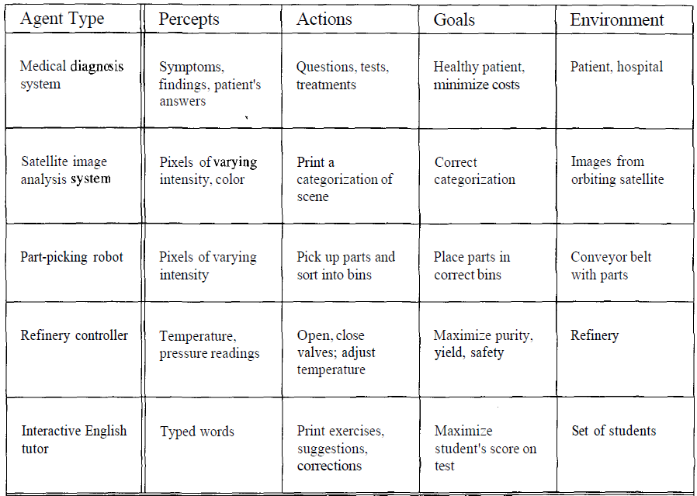
Example of agent types

